Slide 1
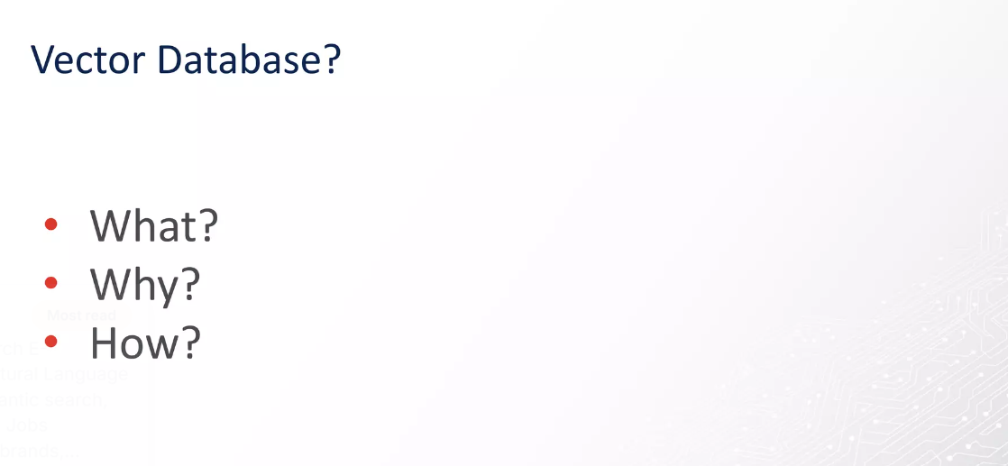

Slide 2
Structured vs Unstructured Data and the Need for Vector Databases
Why modern AI and semantic search require new database architectures

Slide 3
Structured Data
• Organized in rows and columns within predefined schemas
• Examples: SQL Server, MySQL, PostgreSQL
• Ideal for financial transactions, user data, analytics
• Querying via SQL: SELECT, WHERE, JOIN
Example Table:
| ID | Name | Salary | Date |
|----|-------|--------|------|
| 1 | Alice | 5000 | 2025-11-10 |
| 2 | Bob | 4500 | 2025-11-12 |

Slide 4
Limitations of Structured Databases
• Only support structured, numeric, and categorical data
• Cannot natively store or search images, audio, or free text meaningfully
• Searches rely on exact or partial keyword matches
• Schema rigidity — difficult to scale for unstructured data
• Example: Searching 'happy' ≠ 'joyful' (no semantic link)

Slide 5
Unstructured Data
• No fixed schema — includes text, images, videos, audio, documents
• Found in emails, reviews, logs, PDFs, social media
• Cannot be queried easily with SQL syntax
• Usually stored in NoSQL, object stores (MongoDB, AWS S3)
Example:
Review: "This phone takes great pictures in low light!"
→ Hard to find with SQL unless exact keywords match

Slide 6
Limitations of Non-Structured Databases
• Keyword-based retrieval — lacks understanding of context or meaning
• Cannot compare similarity between two sentences or images
• Searching relies on metadata or tags
• Not optimized for high-dimensional vector data
• Struggles with AI-driven tasks like semantic search or recommendations

Slide 7
Why We Need Vector Databases
• Traditional DBs store raw or categorical data — not meaning
• AI models convert data into embeddings (vectors) capturing semantics
• Vector databases store and query these embeddings efficiently
• Use distance metrics (Cosine, L2, IP) to find semantically similar results
Result: Search and recommendation systems that understand meaning.

Slide 8
How Vector Databases Work
1️⃣ Convert data to embeddings using AI model (like OpenAI, Sentence Transformers)
2️⃣ Store embeddings (arrays of numbers) in a Vector Database (Qdrant, Pinecone, FAISS)
3️⃣ Query converts to embedding → finds nearest vectors → returns similar items
Example:
Text/Image ➜ Embedding ➜ Stored in DB ➜ Vector Search (by similarity)

Slide 9
Example: Qdrant Vector Search (Python)
from qdrant_client import QdrantClient
from qdrant_client.models import VectorParams, Distance
client = QdrantClient("http://localhost:6333")
client.create_collection(
collection_name="documents",
vectors_config=VectorParams(size=768, distance=Distance.COSINE)
)
query_vector = [0.12, 0.08, 0.34, ...] # Embedding from a model
results = client.query(
collection_name="documents",
query_vector=query_vector,
limit=3
)
print(results)

Slide 10
Semantic Search Flow
Input Query: "red running shoes"
1️⃣ Text → Embedding via AI model
2️⃣ Compare with stored product vectors
3️⃣ Return closest matches by meaning, not keyword
Results:
• 'Sports sneakers'
• 'Jogging shoes'
• 'Athletic footwear'

Slide 11
Real-World Applications of Vector Databases
• Semantic search in knowledge bases and chatbots
• Image and multimedia similarity search
• Personalized recommendations (e.g., Amazon, Netflix)
• Fraud detection using behavioral pattern vectors
• AI context retrieval in LLM-powered apps (RAG)

Slide 12
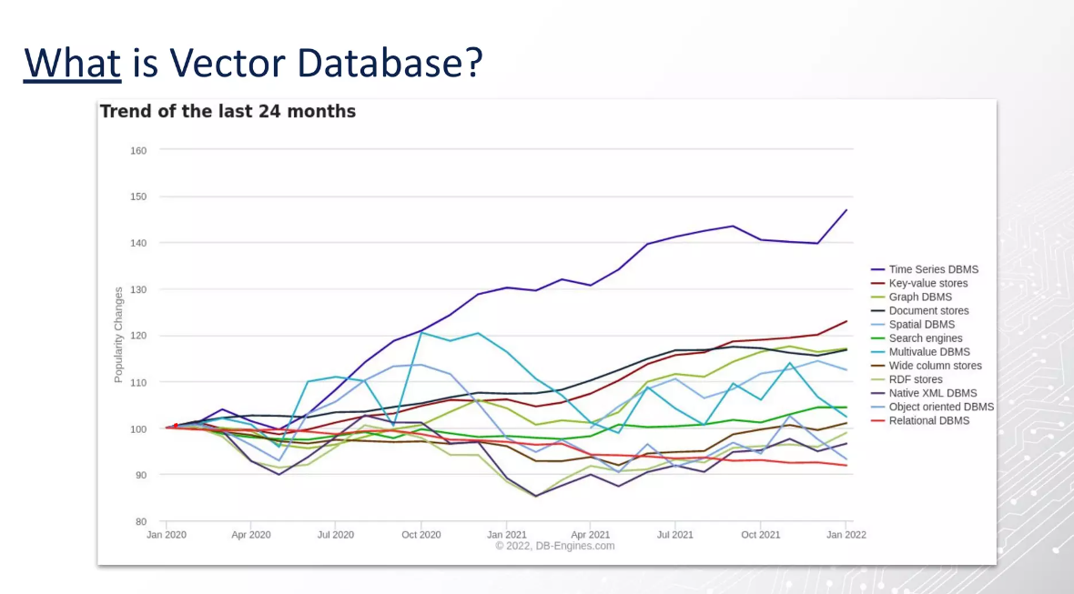

Slide 13
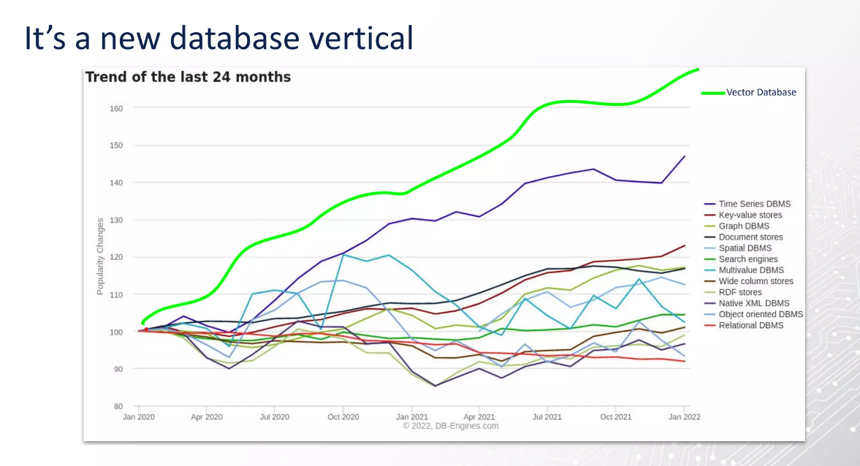

Slide 14
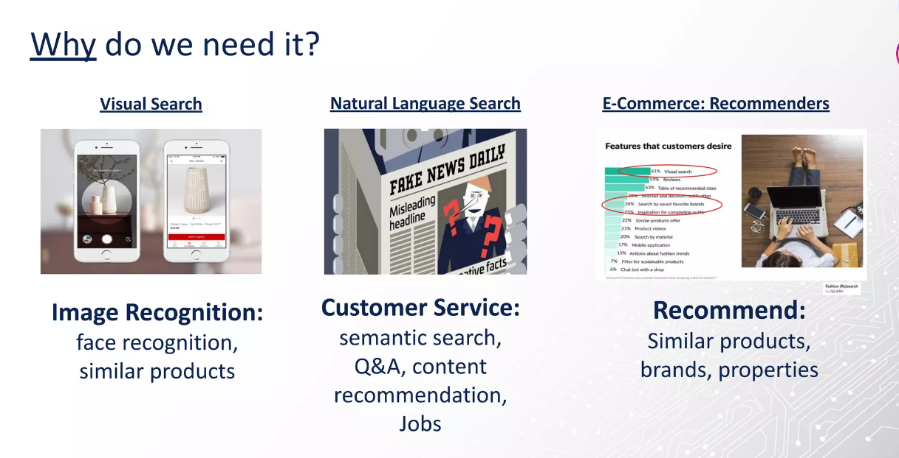

Slide 15


Slide 16
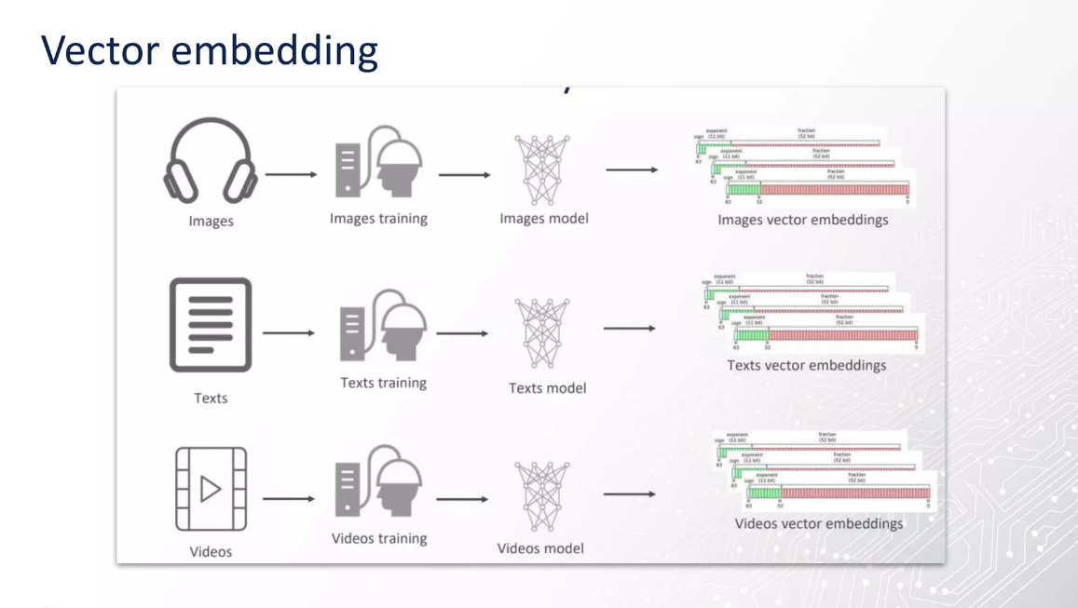

Slide 17
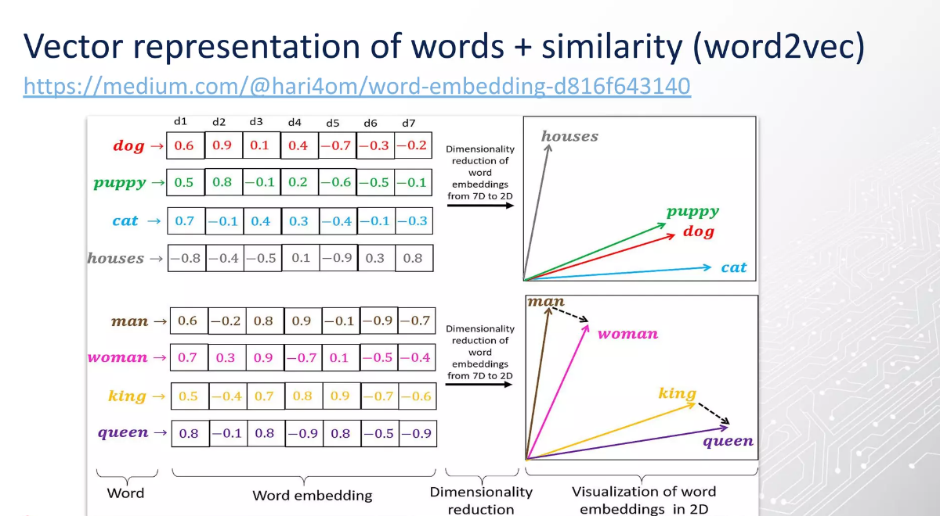

Slide 18
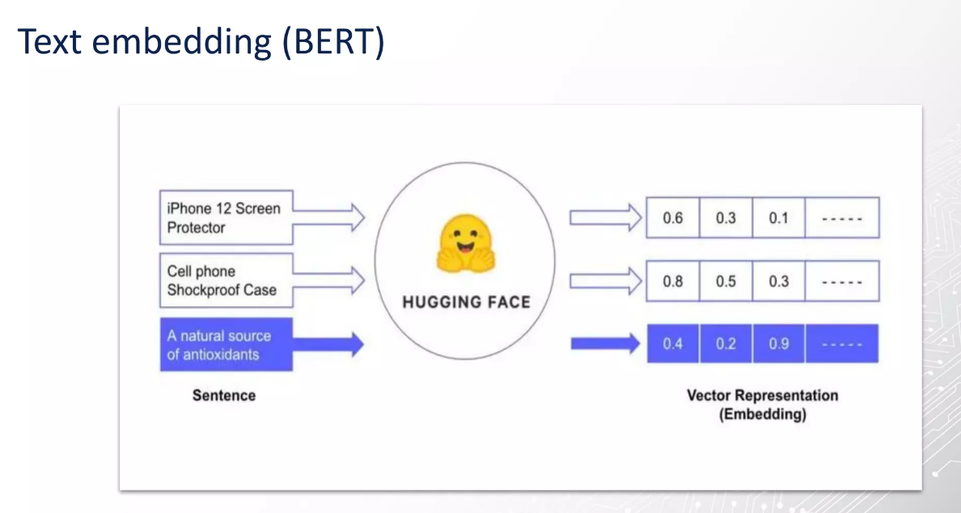

Slide 19
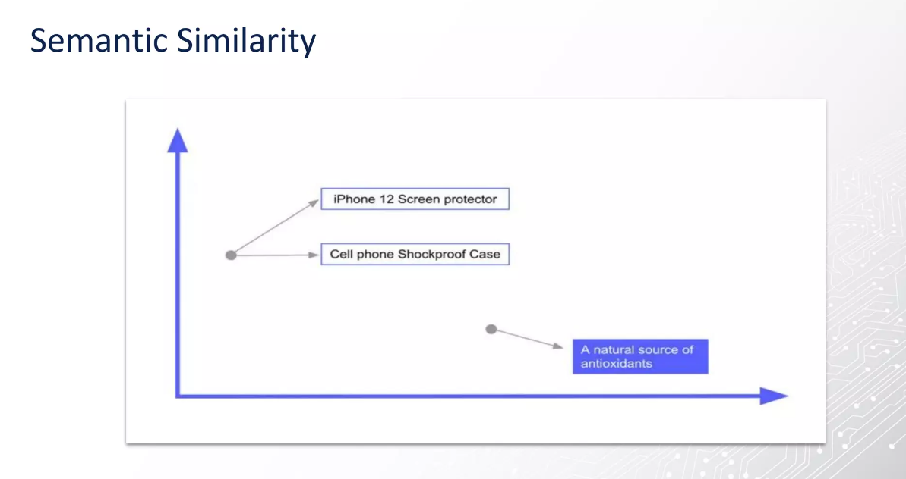

Slide 20
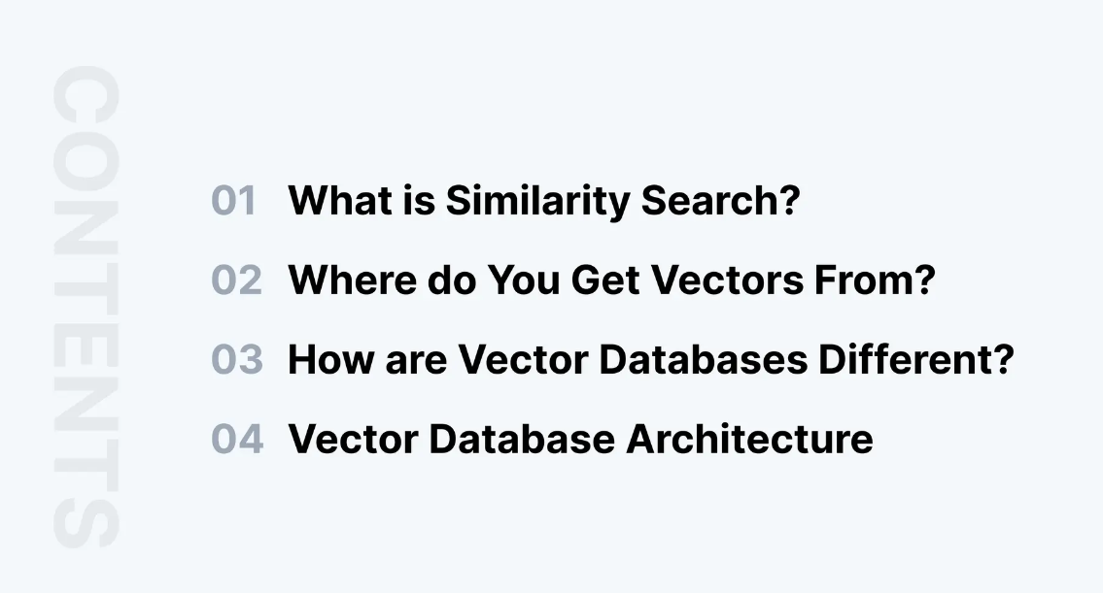

Slide 21


Slide 22
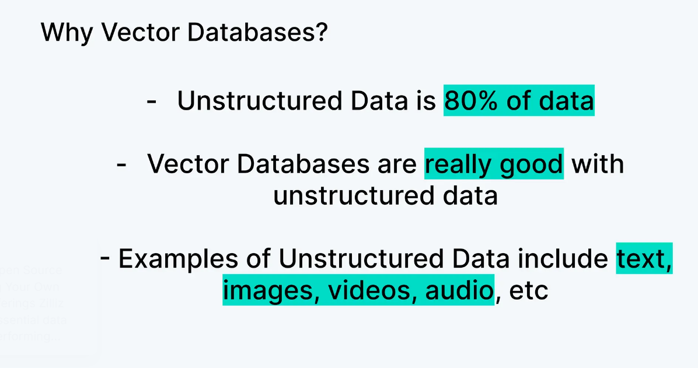

Slide 23
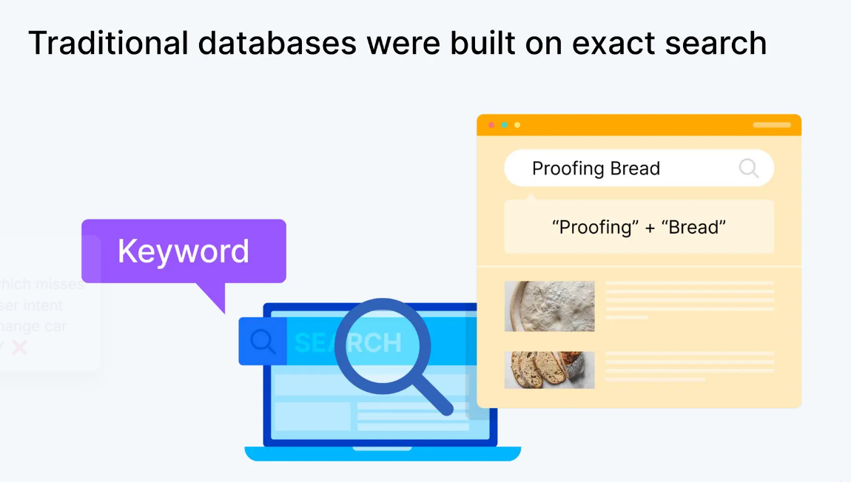

Slide 24
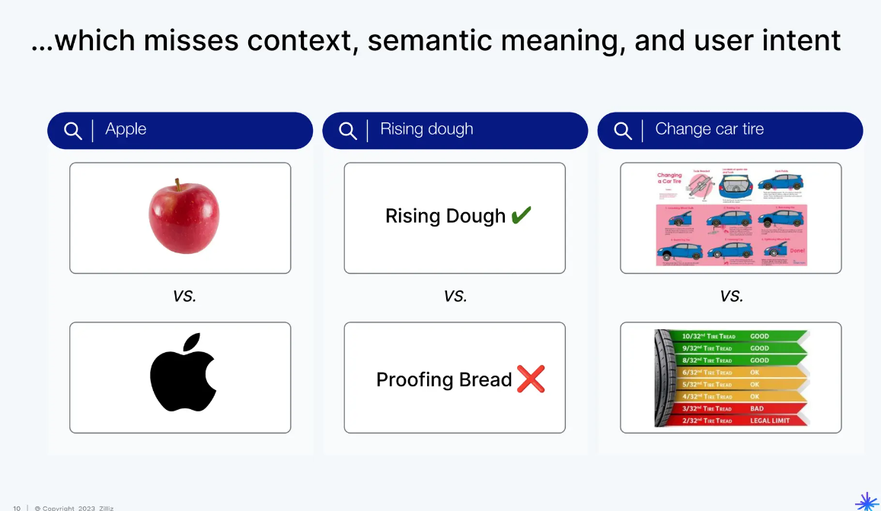

Slide 25
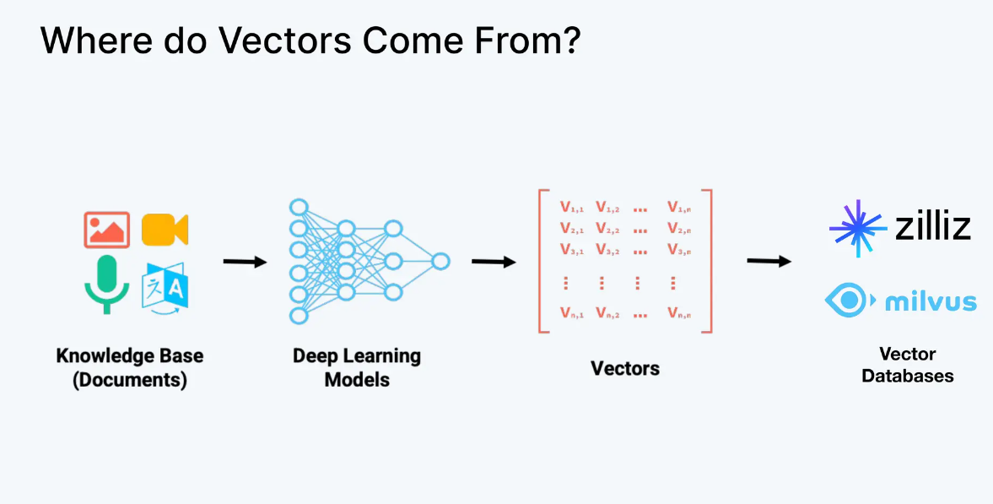

Slide 26
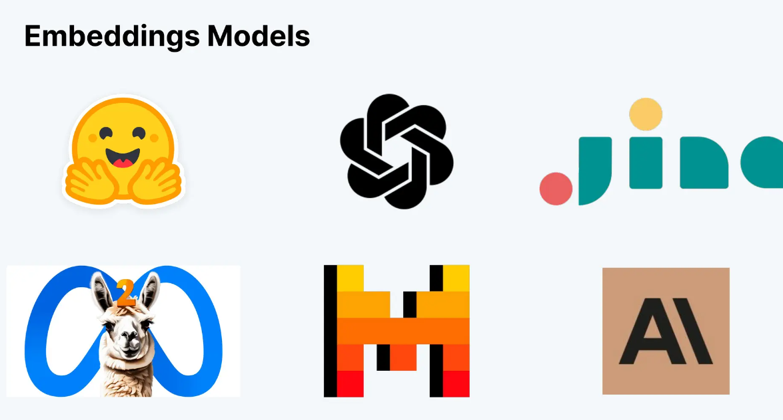

Slide 27


Slide 28
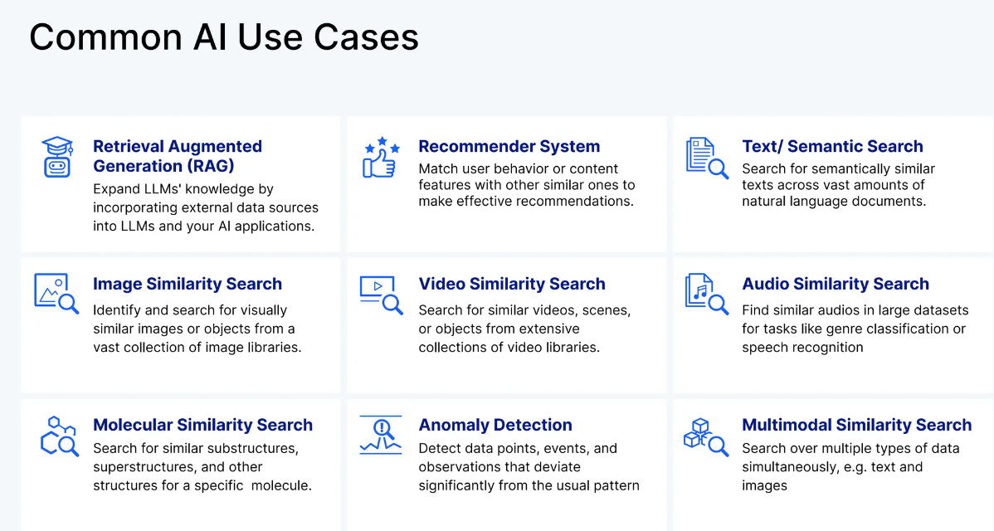

Slide 29
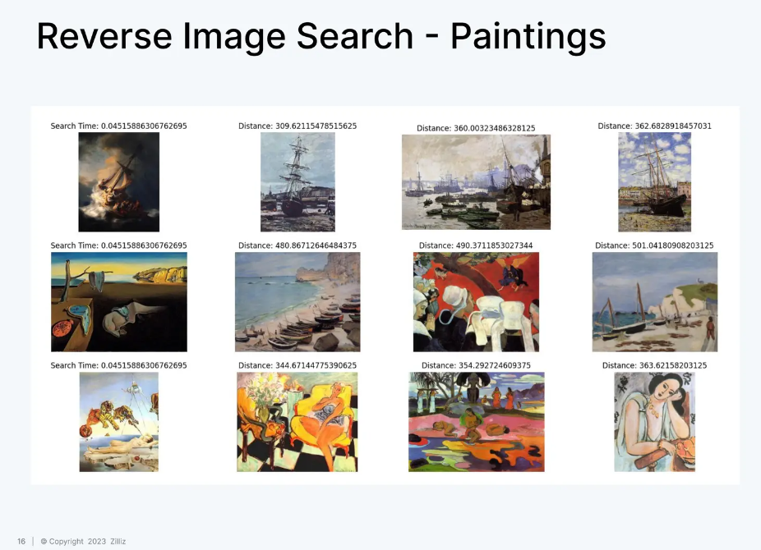
GitHub => https://github.com/ytang07/milvus-projects/blob/main/vision/reverse_painting_search.ipynb

Slide 30
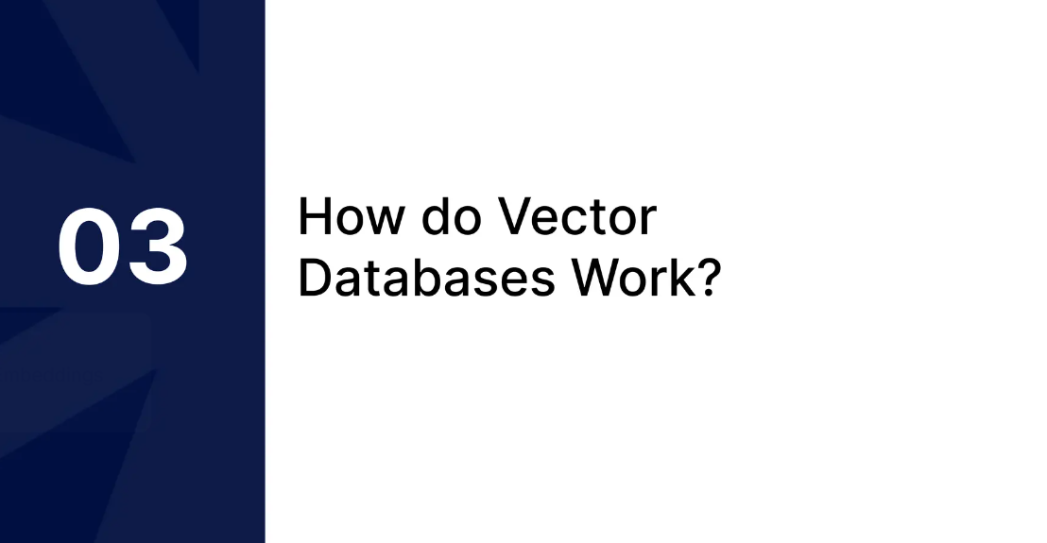

Slide 31
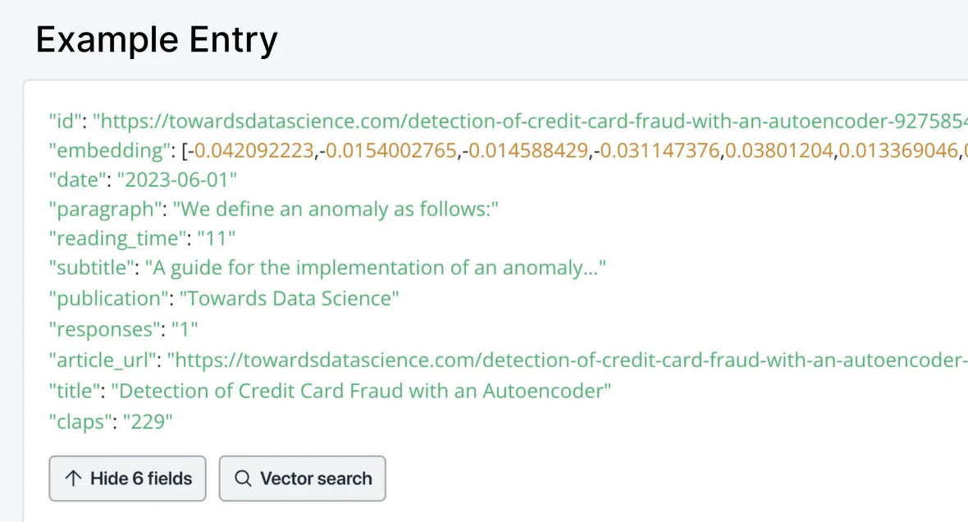

Slide 32


Slide 33
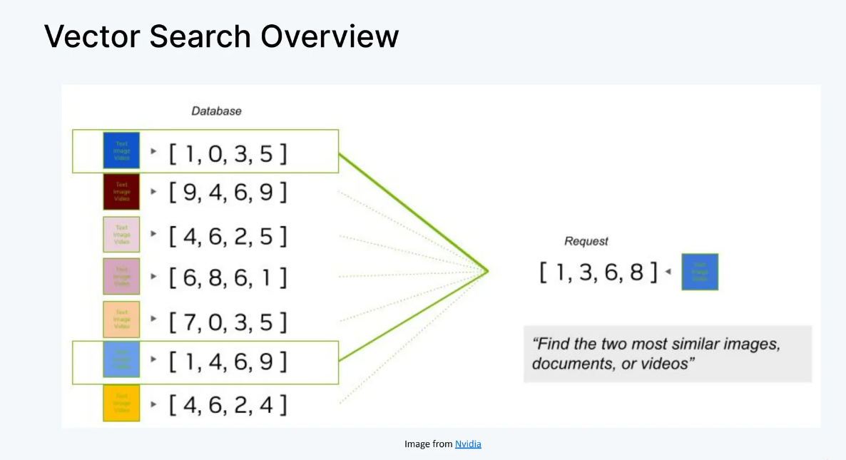

Slide 34
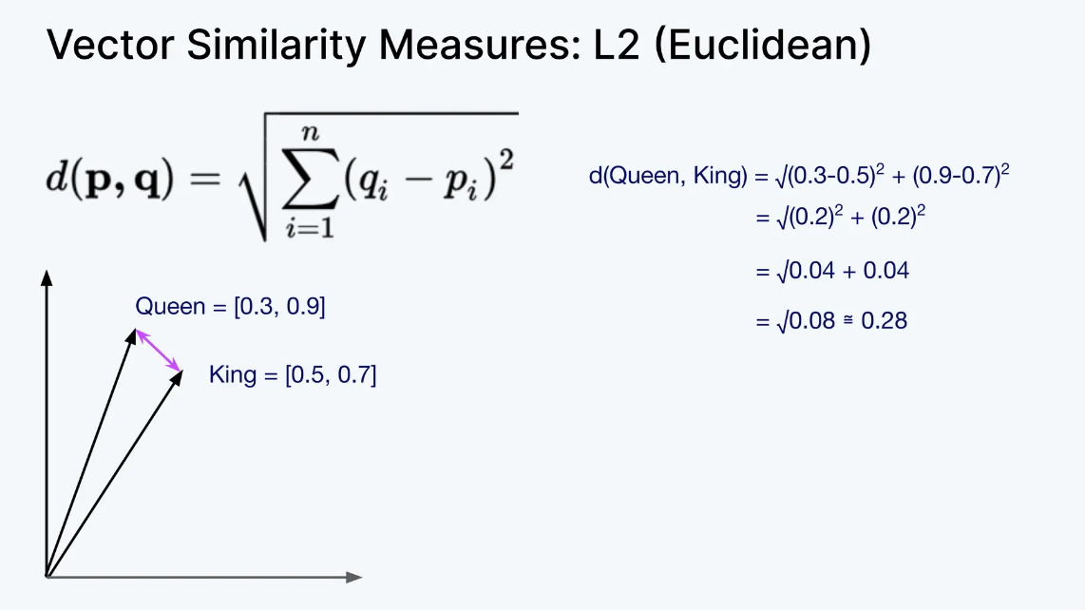
Euclidean Distance Euclidean distance assesses the similarity of two vectors by measuring the straight-line distance between the two vector points. Vectors that are more similar will have a shorter absolute distance between them, while more dissimilar vectors will have a larger distance between one another.

Slide 35
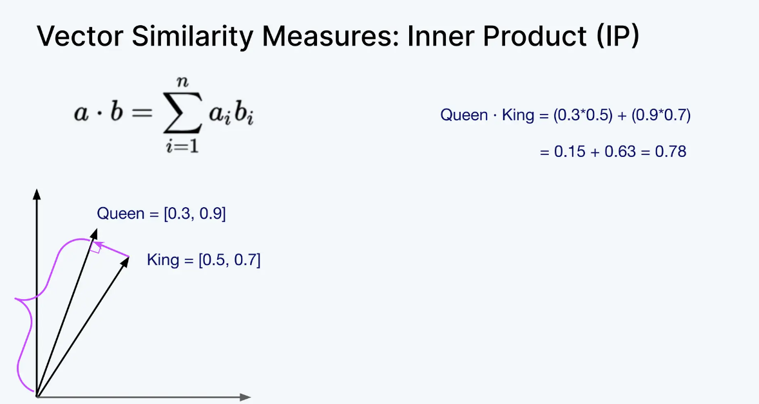
Dot Product
The dot product is a simple measure used to see how aligned two vectors are with one another. It tells us if the vectors point in the same direction, opposite directions, or are perpendicular to each other. It is calculated by multiplying the corresponding elements of the vectors and adding up the results to get a single scalar number.
Press enter or click to view image in full size

Slide 36
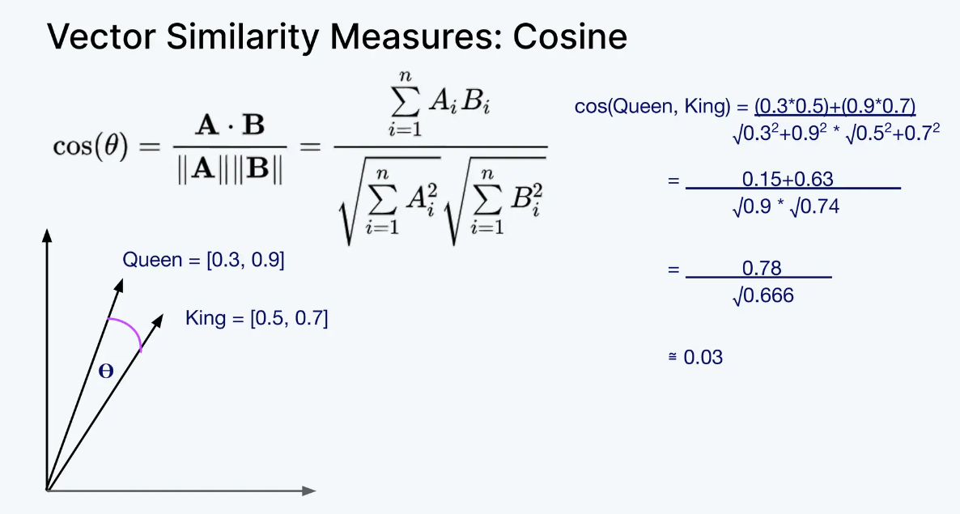
Cosine Similarity Cosine similarity measures the similarity of two vectors by using the angle between these two vectors. The magnitude of the vectors themselves does not matter and only the angle is considered in this calculation, so if one vector contains small values and the other contains large values, this will not affect the resulting similarity value.

Slide 37
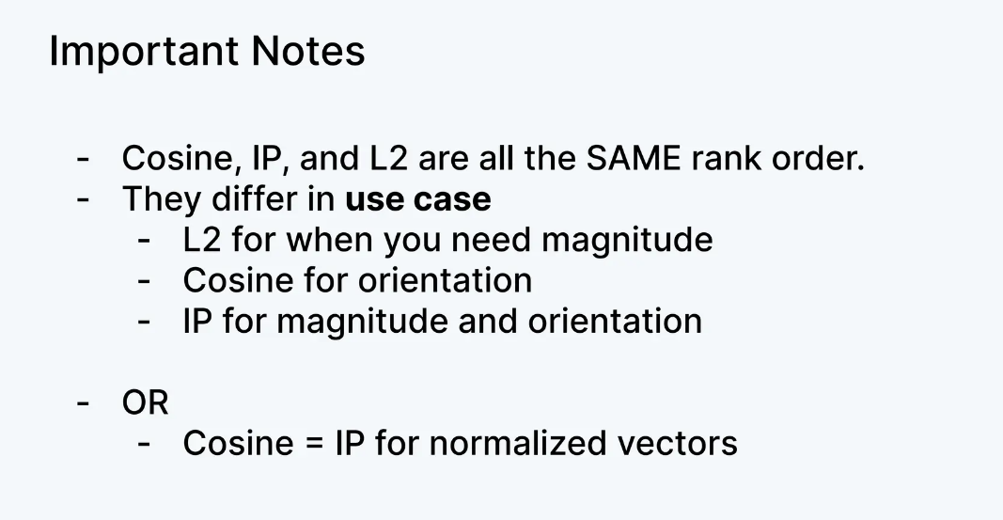
Reference Link => https://medium.com/kx-systems/how-vector-databases-search-by-similarity-a-comprehensive-primer-c4b80d13ce63

Slide 38
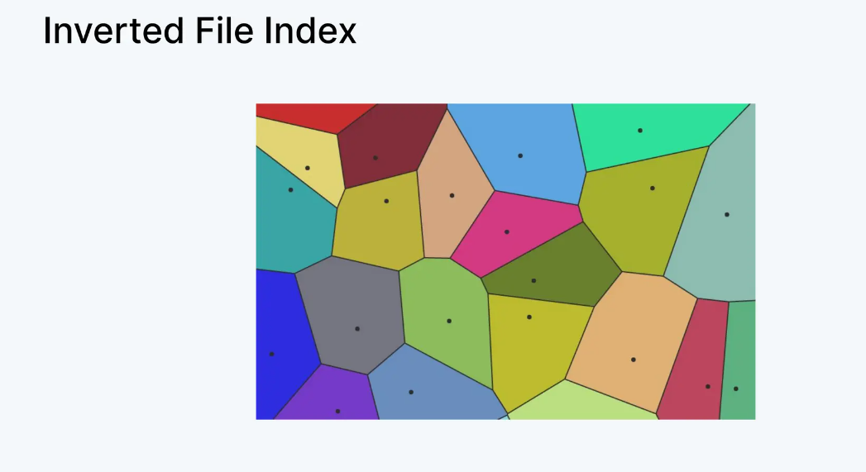

Slide 39
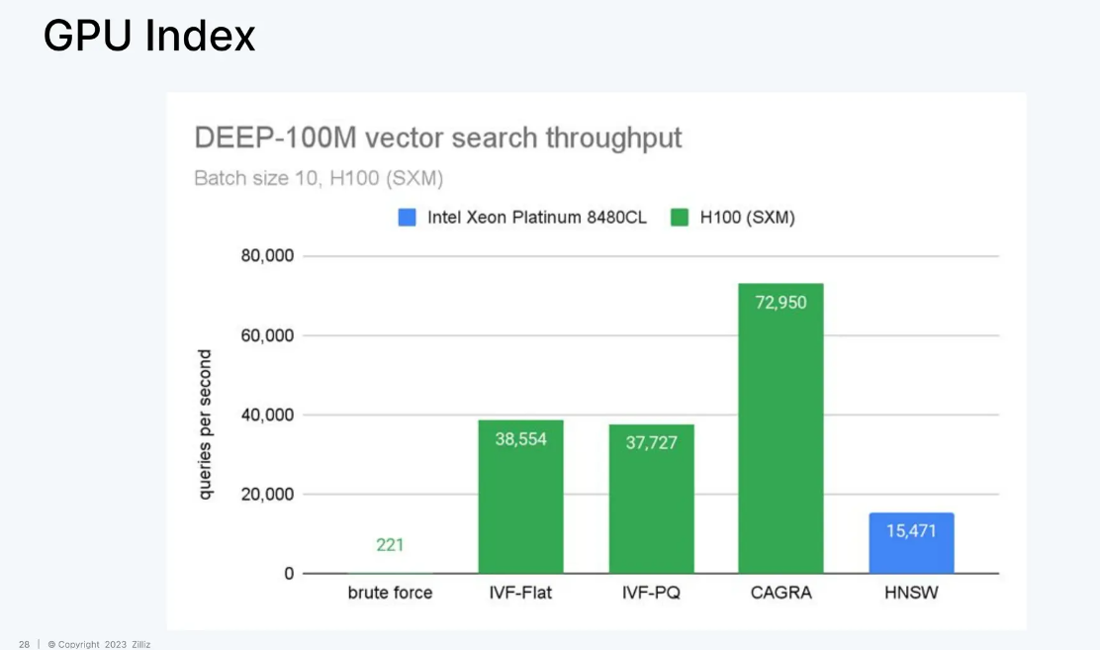

Slide 40
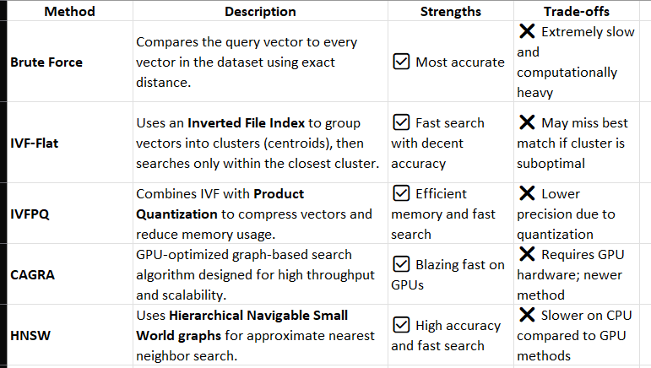
Vector Search Methods

Slide 41
How ChatGPT Understands a Query
From text input to intelligent response generation

Slide 42
Overview
ChatGPT doesn’t truly “know” language — it interprets it using mathematics.
When you type a query, it converts your text into numerical patterns (vectors), understands context using Transformer layers, and predicts the best response.

Slide 43
Step-by-Step: How ChatGPT Processes a Query
1️⃣ Tokenization – Breaks text into tokens (words or parts of words).
2️⃣ Embedding – Converts tokens into vectors that represent meaning.
3️⃣ Transformer Layers – Analyze relationships between words using self-attention.
4️⃣ Context Understanding – Captures full meaning of the sentence.
5️⃣ Response Generation – Predicts the most likely next words to answer.

Slide 44
ChatGPT vs Vector Database
✅ ChatGPT uses vectors internally:
- Represents tokens, sentences, and meaning during processing.
- Vectors are temporary and used in memory.
❌ ChatGPT does NOT use a vector database:
- Model data (weights) are stored as tensors, not searchable vectors.
- Vector DBs are external systems used for retrieval (RAG).

Slide 45
Vectors vs Vector Database
Concept | Used by ChatGPT? | Purpose
Vectors (Embeddings) | ✅ Yes | Represent meanings internally during understanding.
Vector Database | ❌ No | Used externally for semantic search and retrieval (RAG).

Slide 46
Visual Flow Summary
User Input → Tokenization → Embedding → Transformer Layers → Context Understanding → Response Generation
Each stage converts text into deeper layers of numerical meaning until the model generates an intelligent, coherent response.

Slide 47
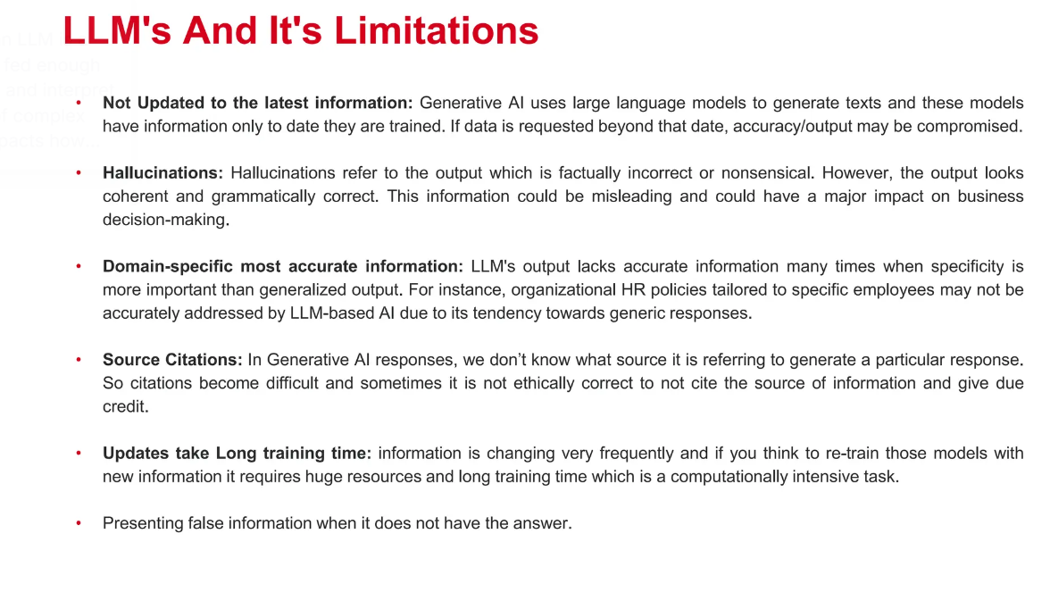

Slide 48
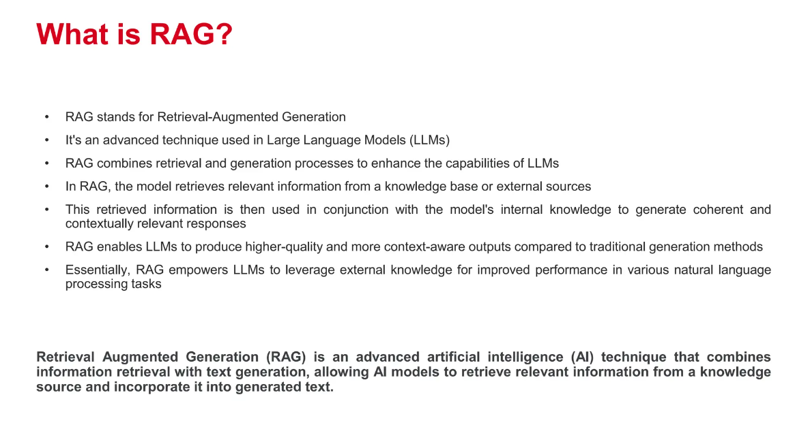

Slide 49
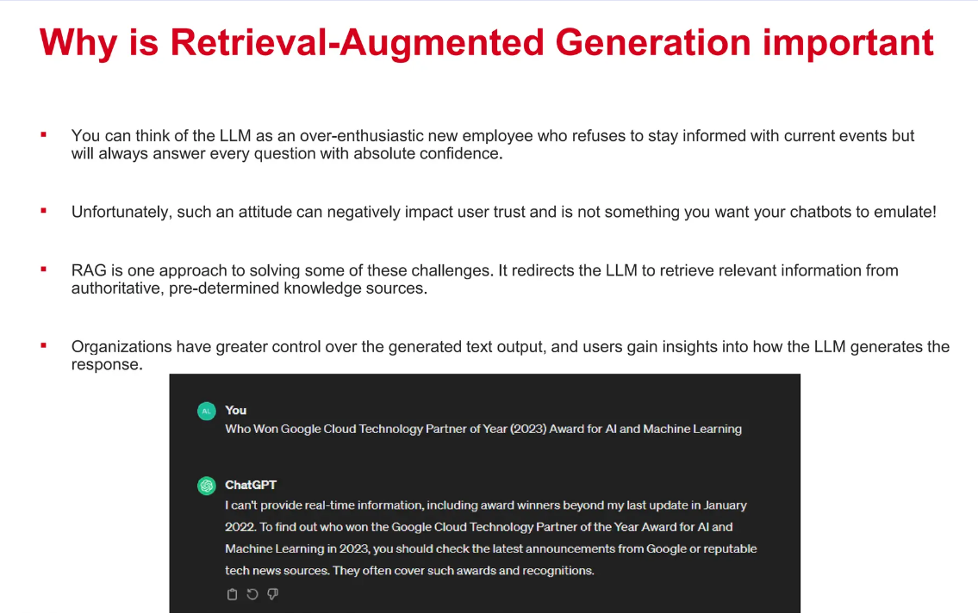

Slide 50


Slide 51
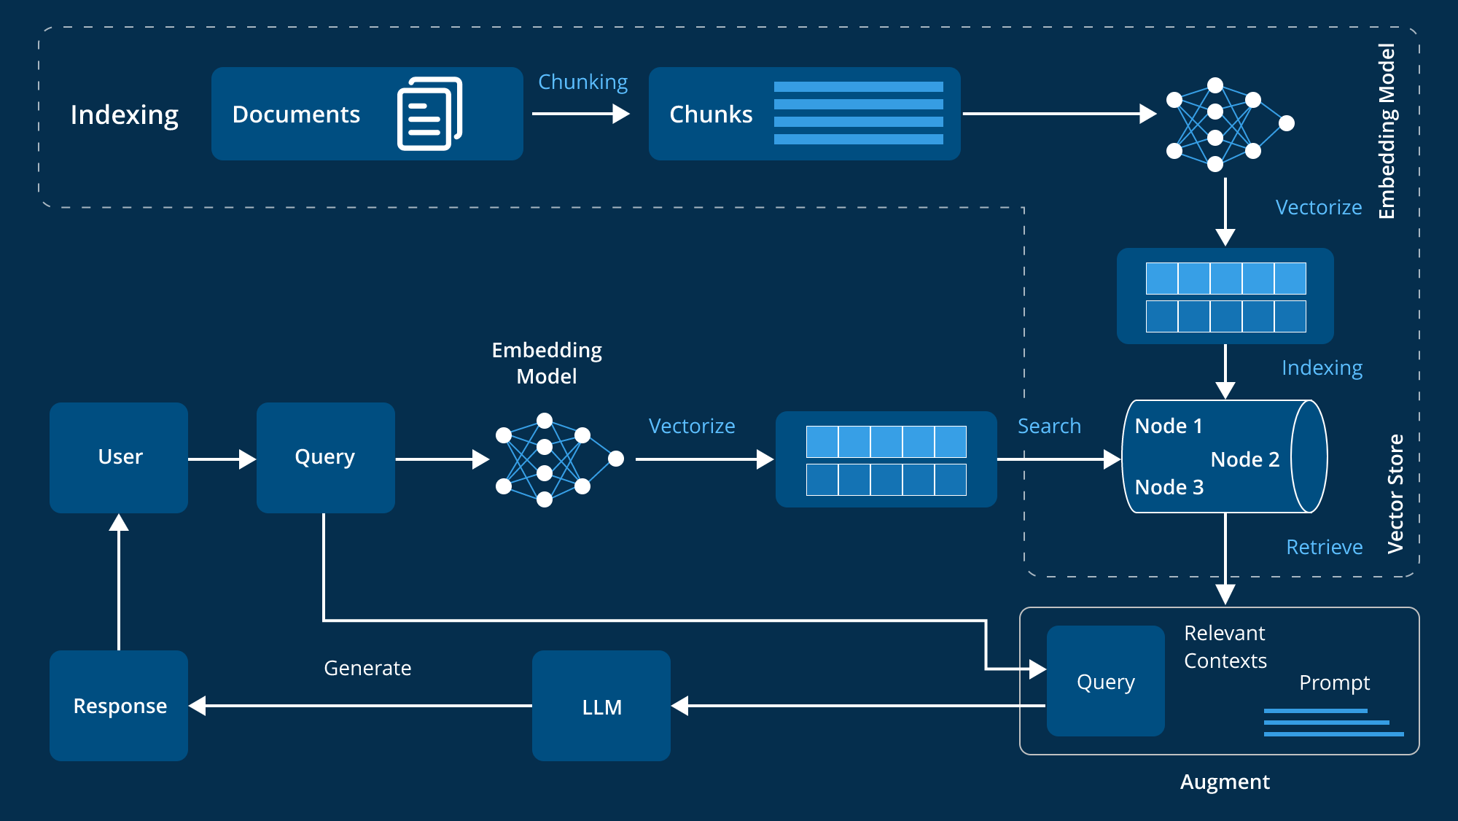

Slide 52
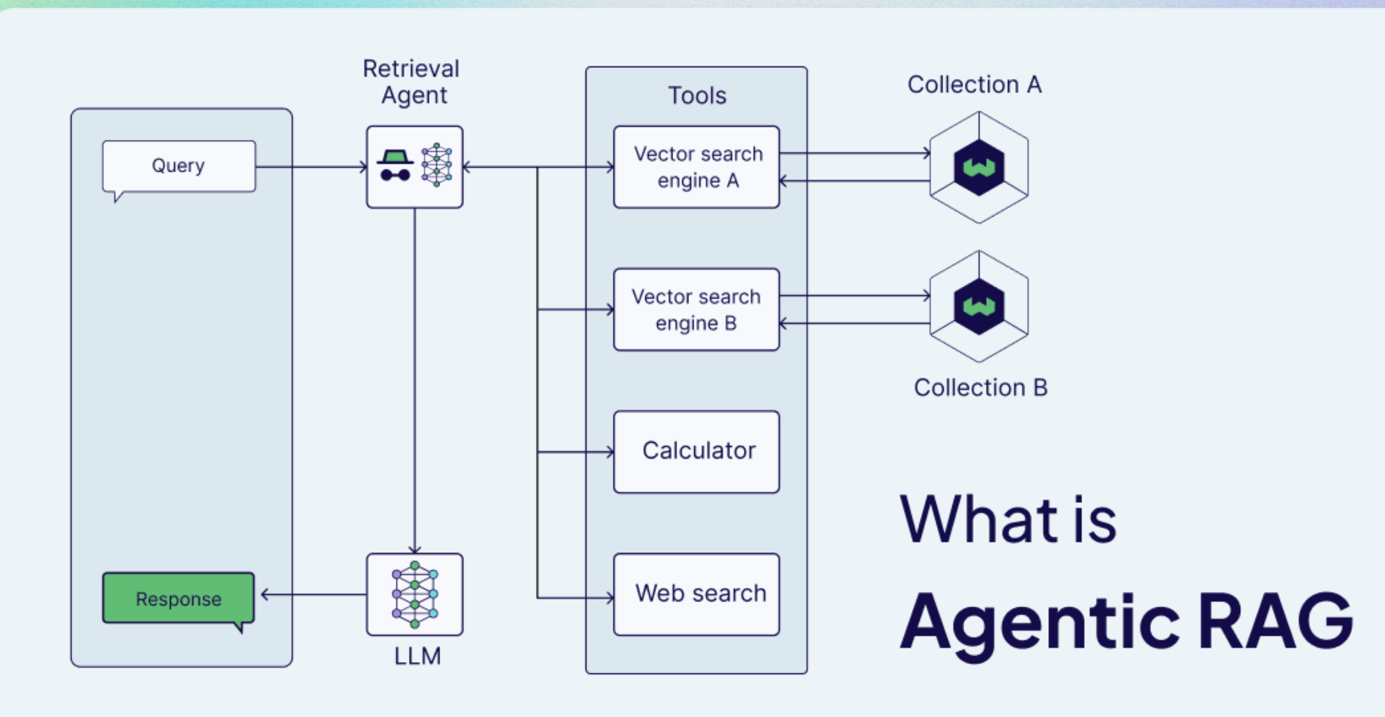

Slide 53
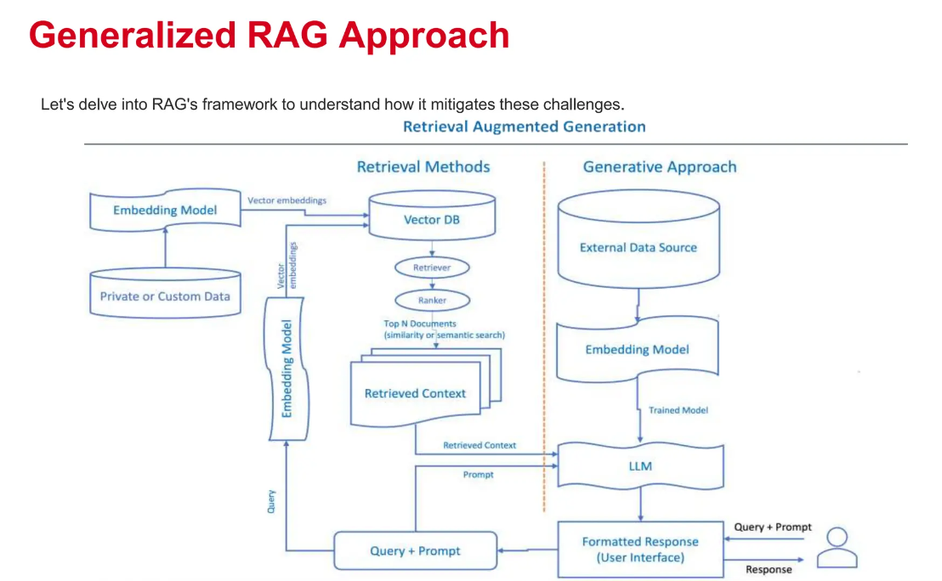

Slide 54
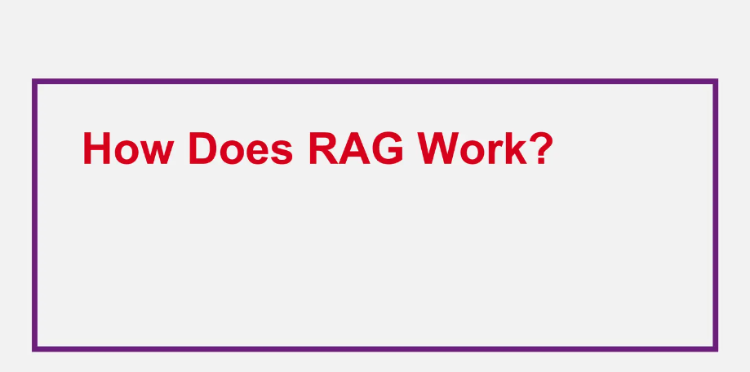

Slide 55
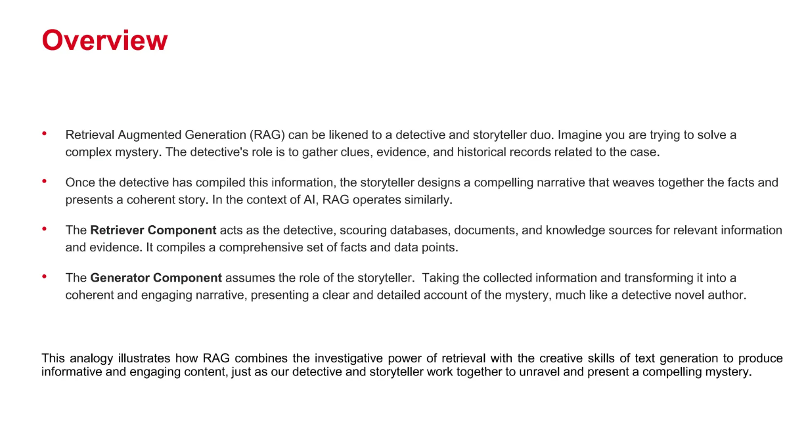

Slide 56
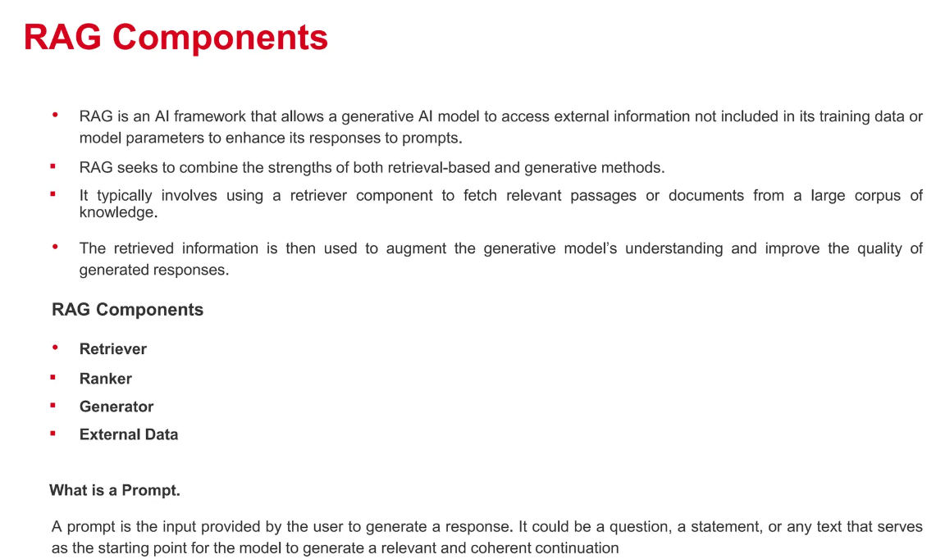

Slide 57
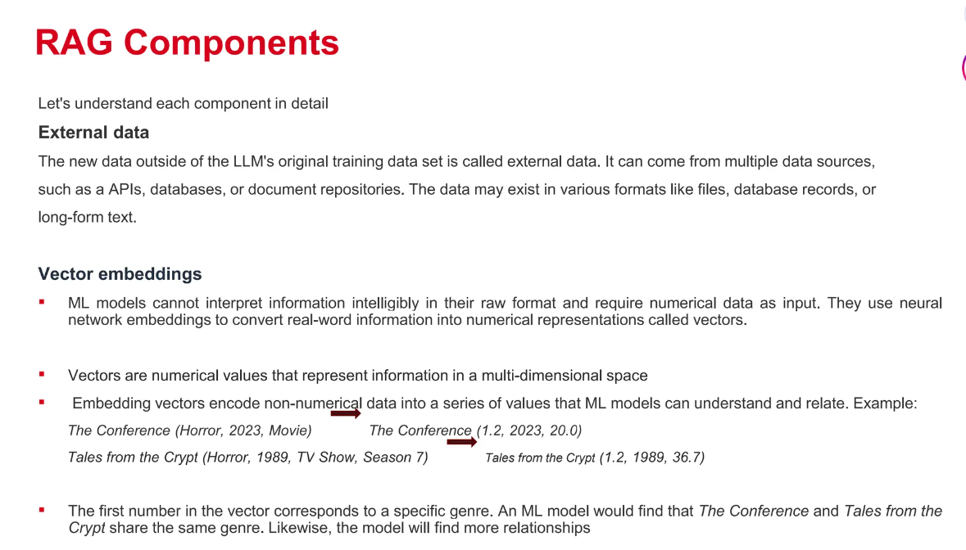

Slide 58
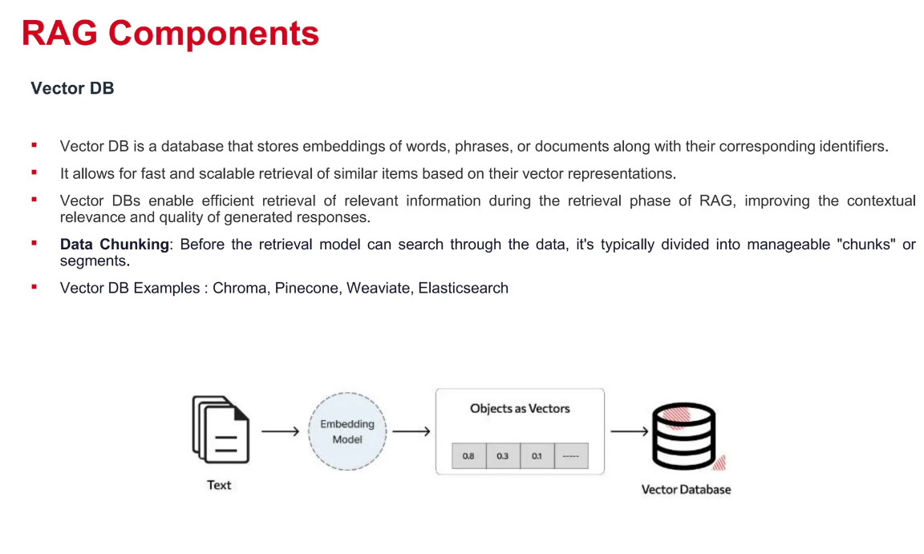

Slide 59
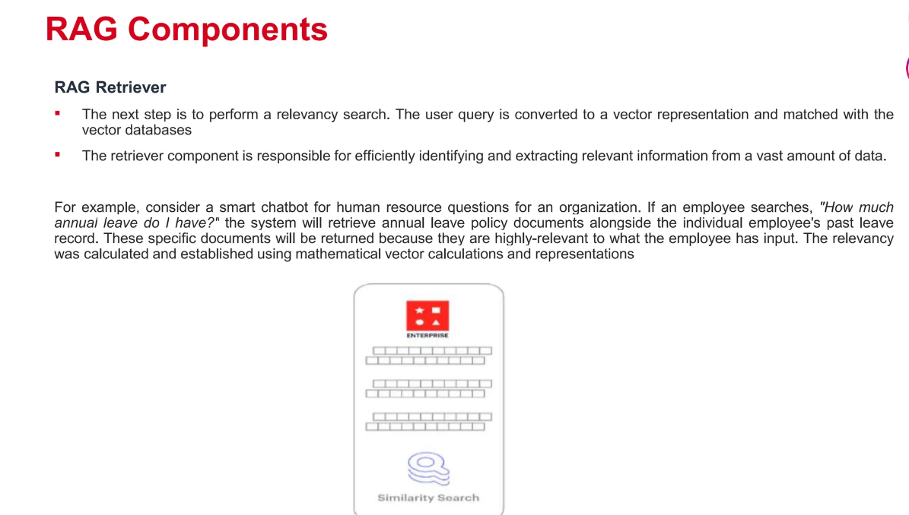

Slide 60
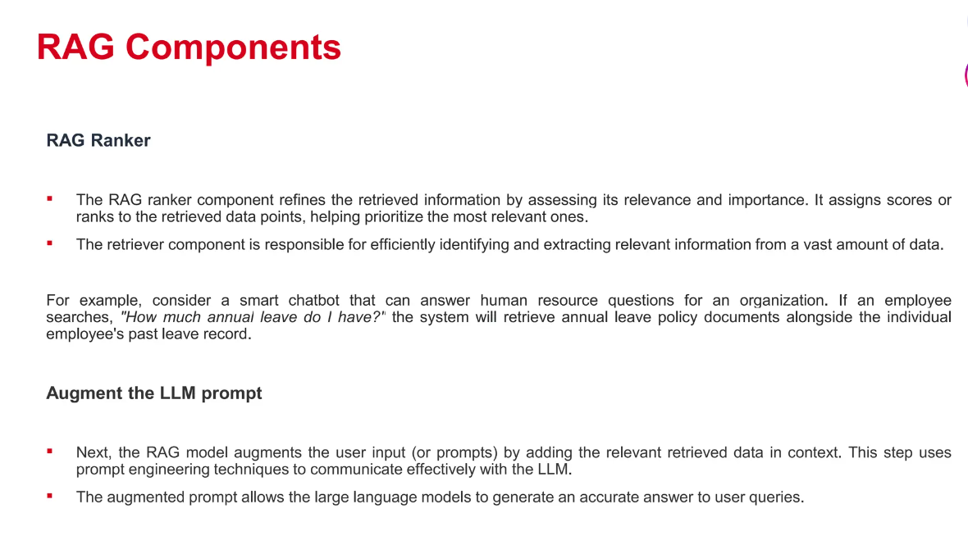

Slide 61
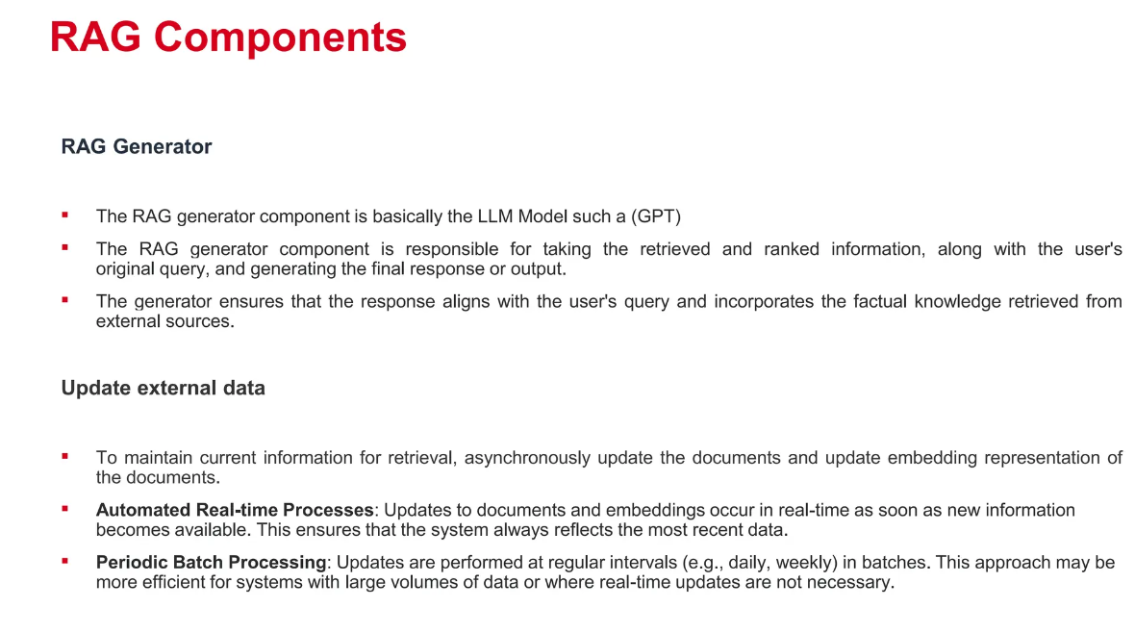

Slide 62
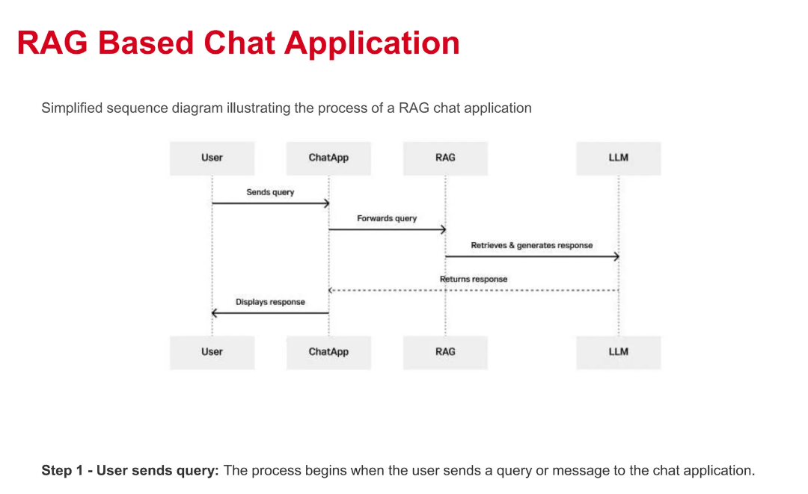

Slide 63
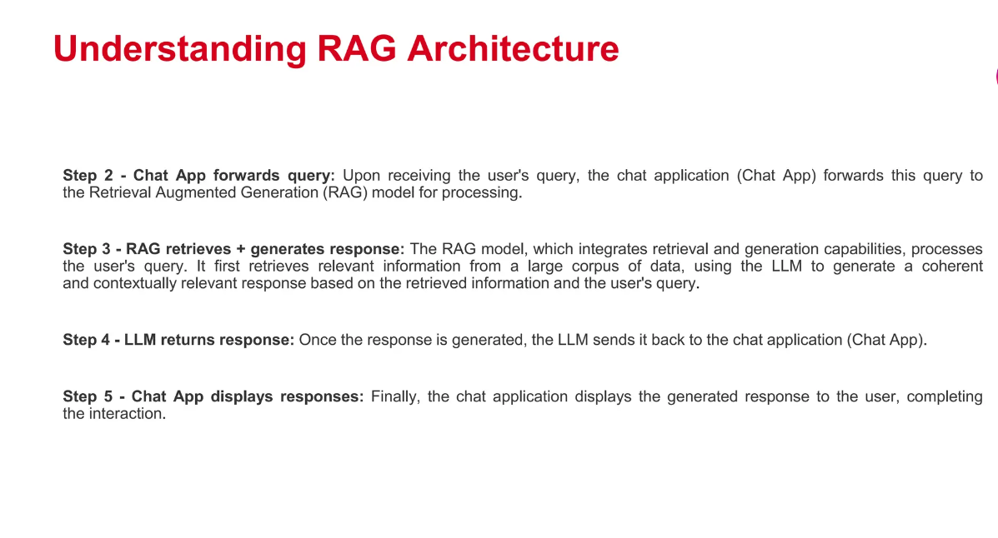

Slide 64
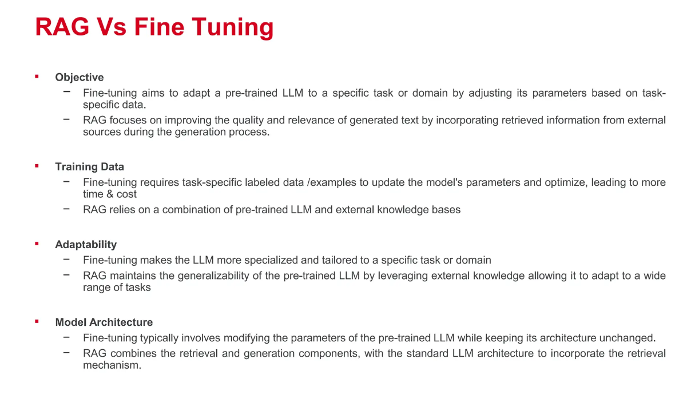

Slide 65
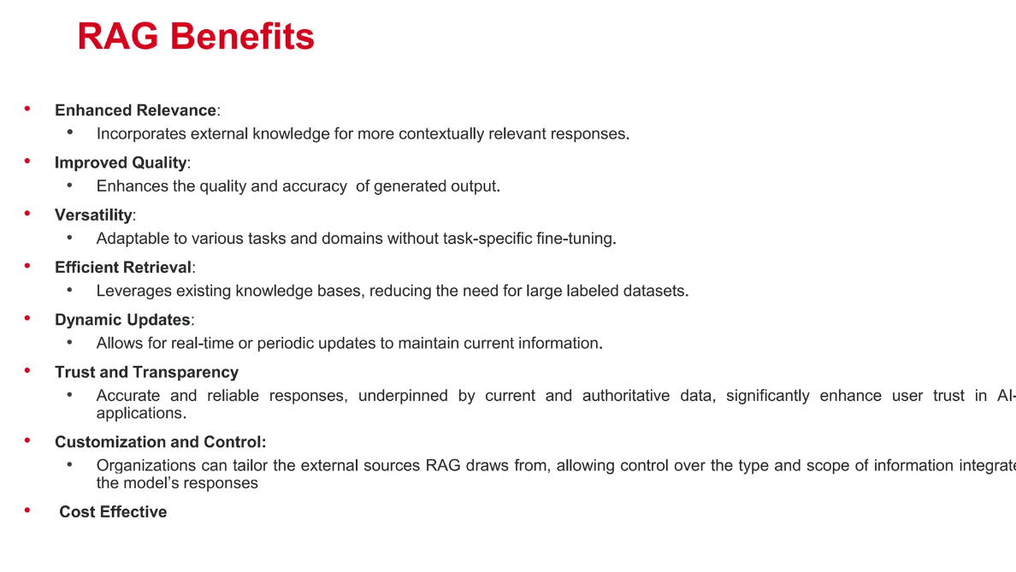

Slide 66
